Slide 1
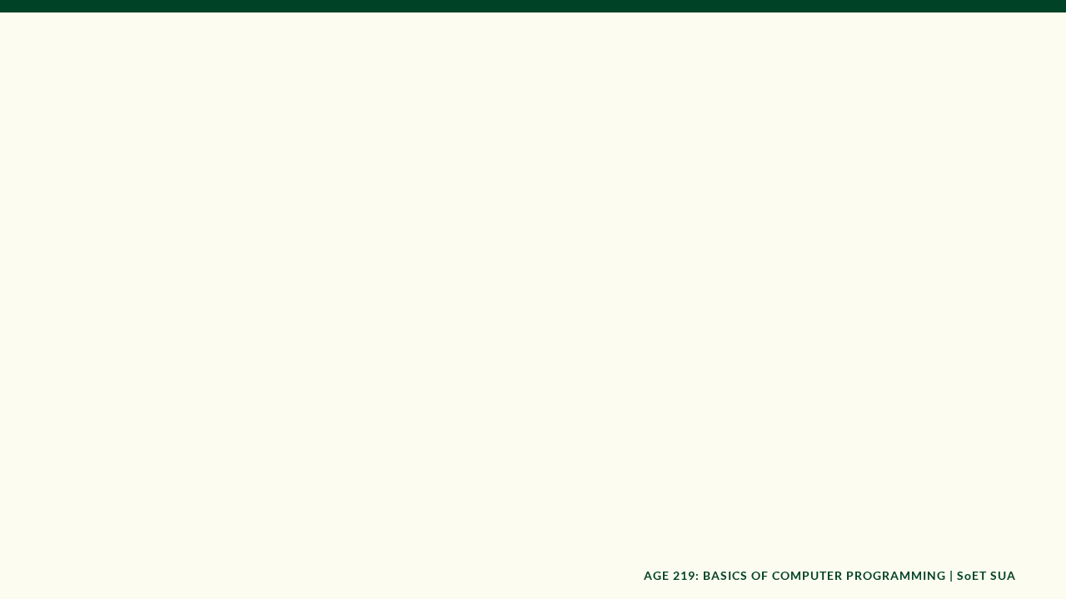

AGE 219: Basics of
Computer Programming
School of Engineering and Technology (SoET)
Dr. Kadeghe Fue, PhD, P.Eng (T)
Specializing in AI and Robotics | Office: EPAL

Slide 2

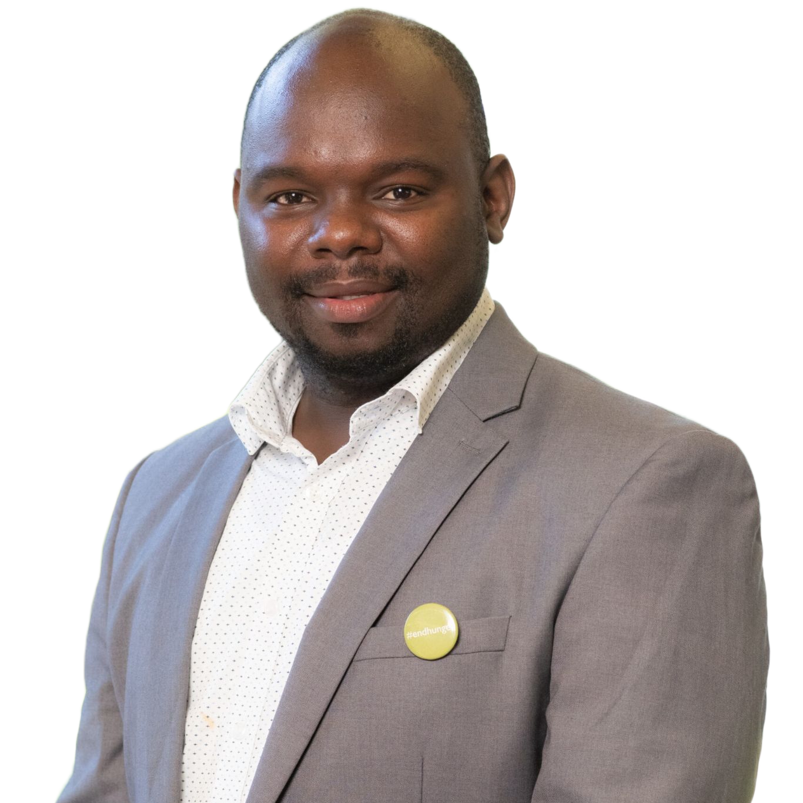
Your Instructor
Dr. Kadeghe Fue
Expertise: PhD in Engineering, specializing in Artificial Intelligence and Robotics for tropical agriculture.
Location: Engineering Precision Agriculture Lab (EPAL).
Vision: Integrating digital twins and autonomous systems into Sokoine University of Agriculture's engineering curriculum.

Slide 3
Course Assessment Strategy
Assessment Component | Frequency | Weighting
Hands-on Assignments | 4 Components | Continuous Assessment
Periodic Practical Tests | 2 Tests | In-semester Grading
University Examination (UE) | 1 Final Exam | Final Competency Check
Total Evaluation | - | 100%

Slide 4






The Honest Clause
Integrity
Originality
Vetting
As engineers at SoET, professional integrity is paramount. Your logic must be your own work.
Directly copying code from peers or internet repositories is strictly prohibited.
You must be prepared to defend every line of code during practical viva sessions.

Slide 5

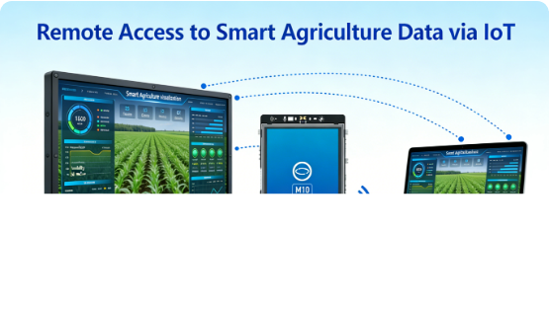
Responsible Use of AI
AI tools like ChatGPT or Gemini are powerful tutors but dangerous crutches.
•
Concept Learning: Use AI to explain difficult syntax or algorithms.
•
No Generation: Do not use AI to generate your assignment solutions.
•
Verification: AI "hallucinates" code; you are responsible for physical accuracy.

Slide 6
Course Roadmap (Part 1)
1. Introduction
2. Variables
The Colab Environment & Foundations of Digital Engineering.
Data types, storage in RAM, and basic mathematical operators.
3. Control Flow
4. Iteration
Logical decision-making using IF, ELIF, and ELSE structures.
Automating repetitive tasks with FOR and WHILE loops.

Slide 7
Course Roadmap (Part 2)
5. Functions
6. Data Structures
Modular and reusable engineering code blocks.
Organizing data in Lists, Tuples, and Dictionaries.
7. File Handling
8. Classes & OOP
Reading and writing sensor data to CSV and TXT files.
Modeling agricultural machines as digital objects.

Slide 8

Module 1
Foundations of Agricultural Informatics

Slide 9

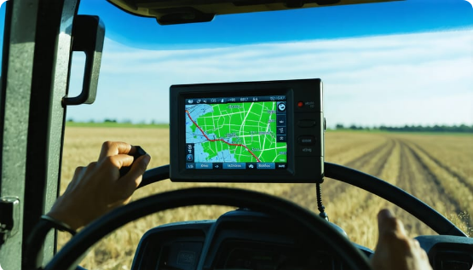
Agriculture 4.0 Informatics
Engineering is no longer just about mechanical strength; it's about digital intelligence.
The Digital Twin: Programming allows us to create virtual replicas of tractors and irrigation systems to optimize performance.
In AGE 219, we learn the language that connects hardware to intelligence.

Slide 10






Machine Architecture
CPU
RAM
Storage
The "Manager." Executes mathematical and logical instructions.
The "Workbench." Stores temporary data currently in use.
The "Silo." Long-term persistent storage for logs and files.

Slide 11
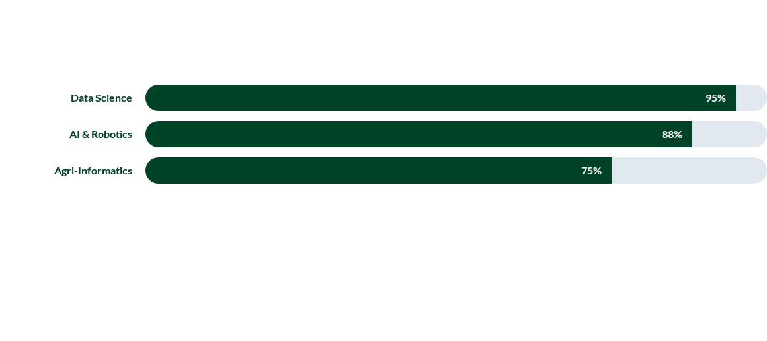
Why Python? (Industry Standards)
Python is the preferred language for engineers due to its readable syntax and massive scientific libraries like NumPy and Pandas.

Slide 12

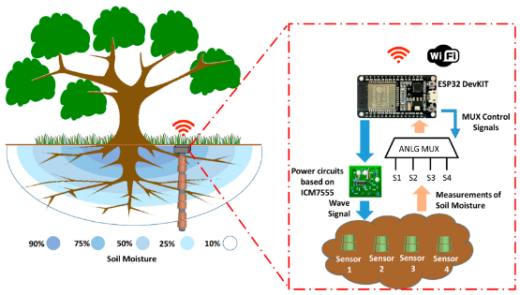
The IPO Model
Input - Process - Output
Every agricultural program follows this engineering flow:
•
Input: Soil moisture sensor readings.
•
Process: IF moisture < 30% AND Time is 6 PM.
•
Output: Open solenoid irrigation valve.

Slide 13
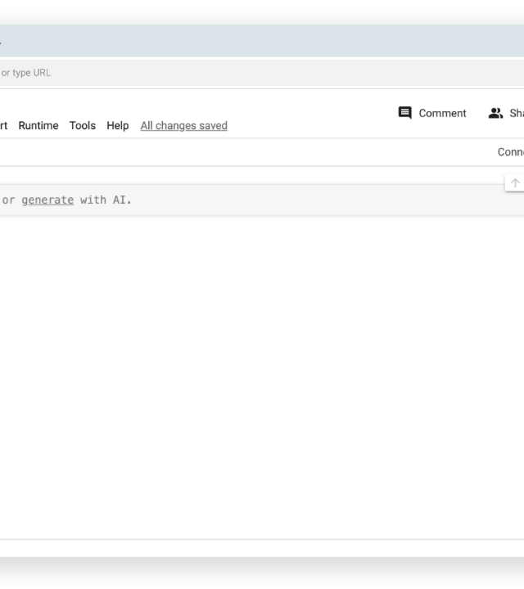
Google Colaboratory
Colab is our primary development environment. It is a cloud-based Jupyter Notebook that requires zero local installation.
Benefits:
•
Zero configuration.
•
Auto-saves to Google Drive.
•
Collaboration built-in.

Slide 14




Colab Cell Types
Text (Markdown)
Code Cells
Used for engineering documentation, mathematical equations (LaTeX), and project titles.
Contains the actual Python instructions. Executed using Shift + Enter.

Slide 15
Algorithmic Thinking
Case Study: Smart Grain Silo Ventilation
Read internal temperature and external humidity.
Compare against target grain equilibrium moisture content.
Calculate if fans should be toggled for energy efficiency.
Log operation time to "silo_telematics.csv".

Slide 16


Questions & Discussion
Next Lecture: Variables, Constants, and Data Types.
School of Engineering and Technology (SoET)
Office: EPAL | SUA Morogoro

